Slide 1

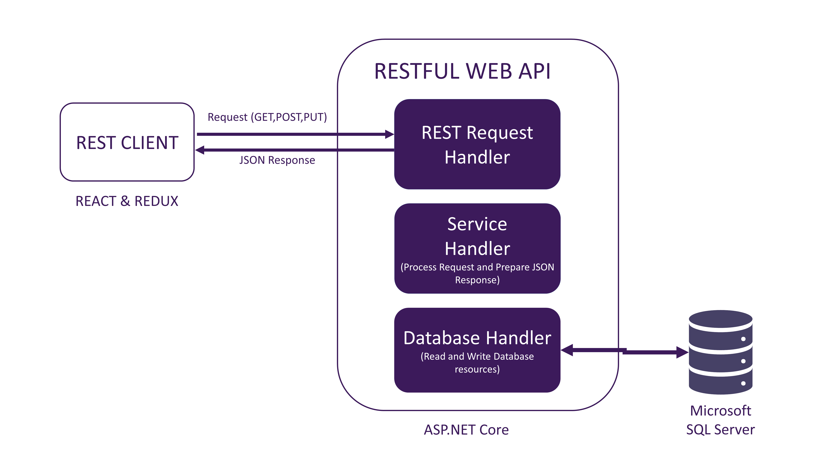



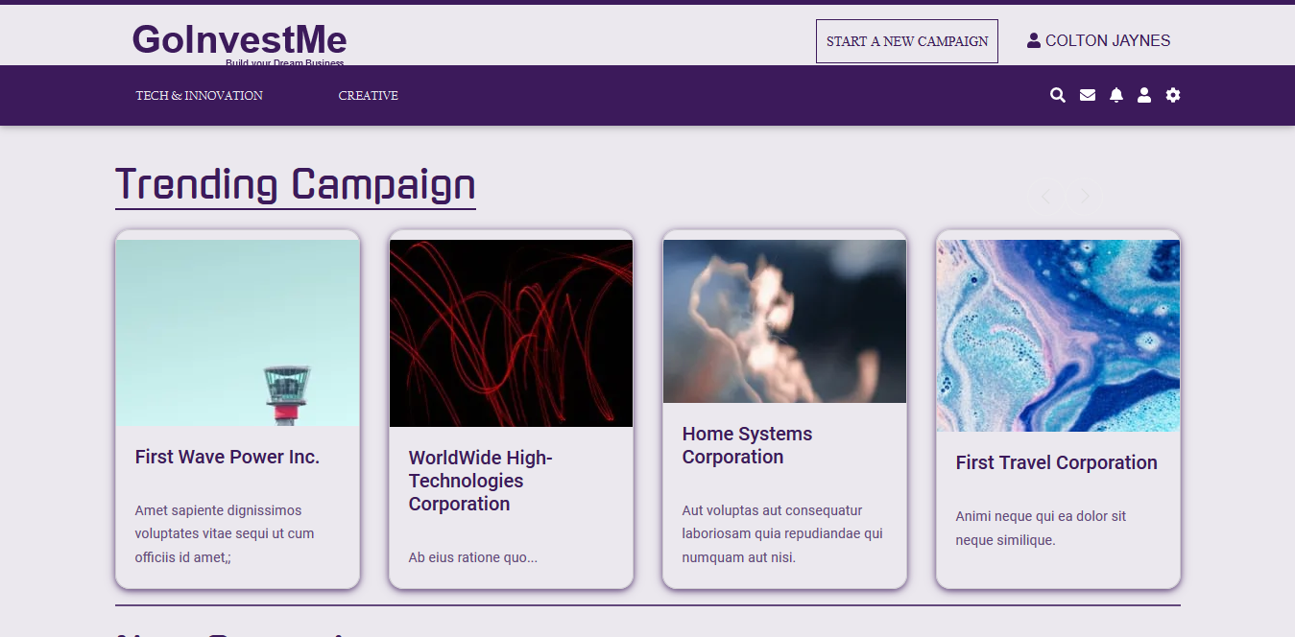
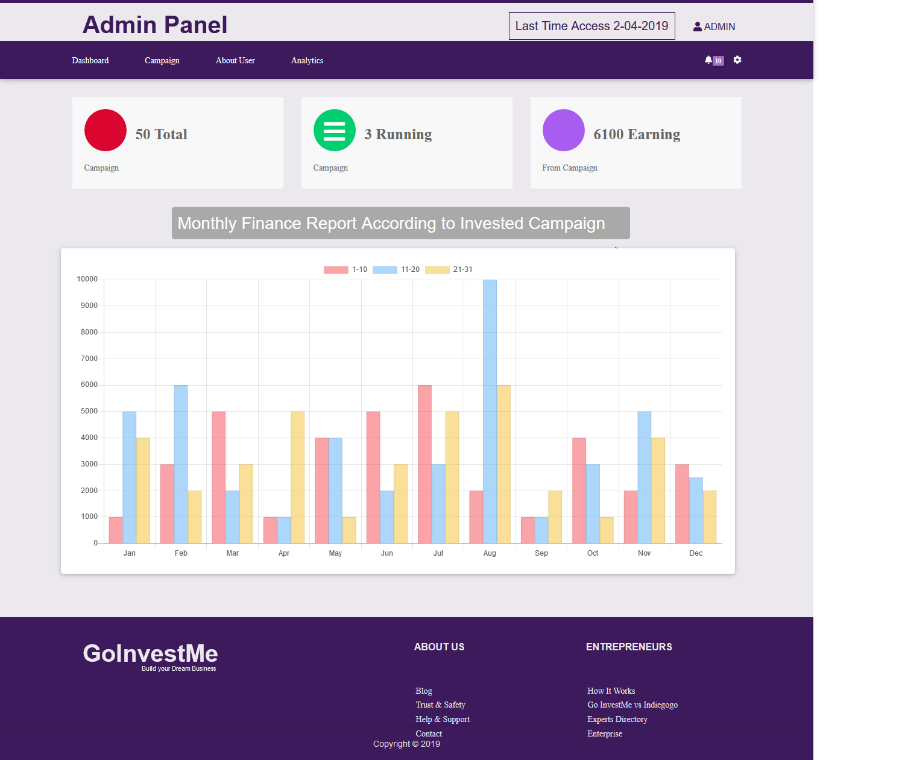
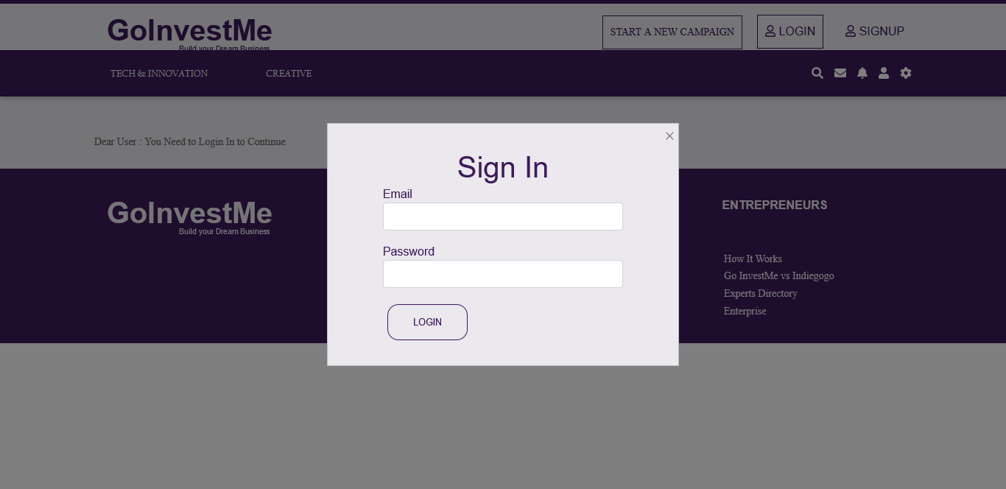
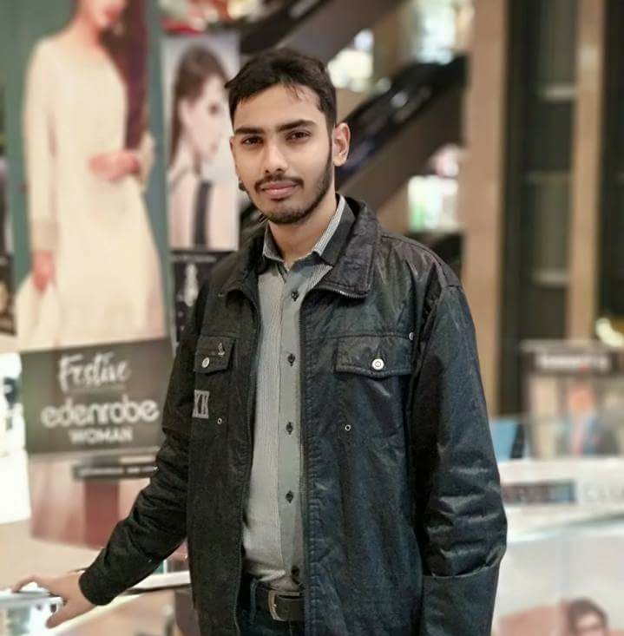
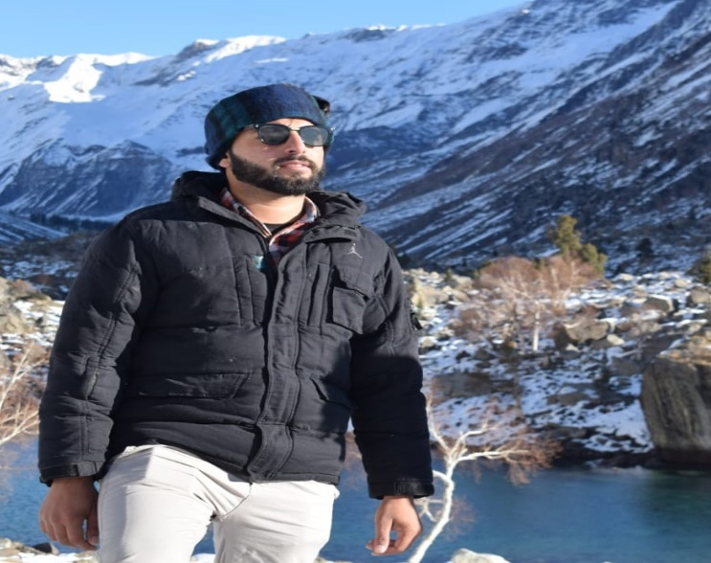
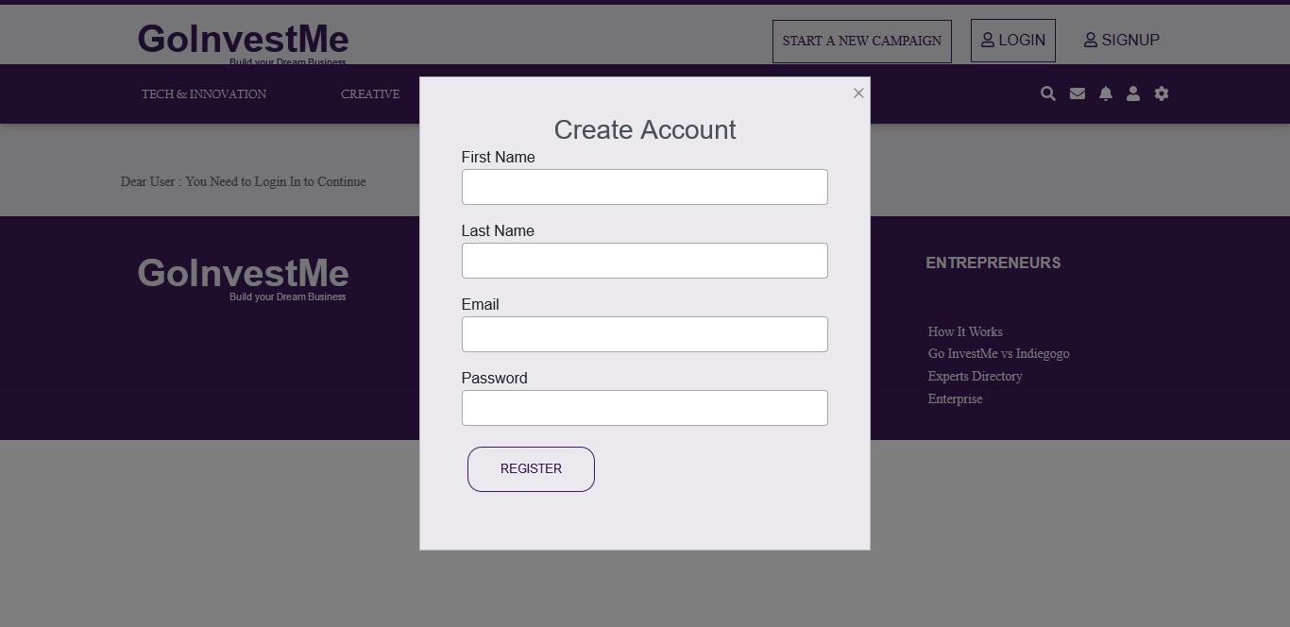
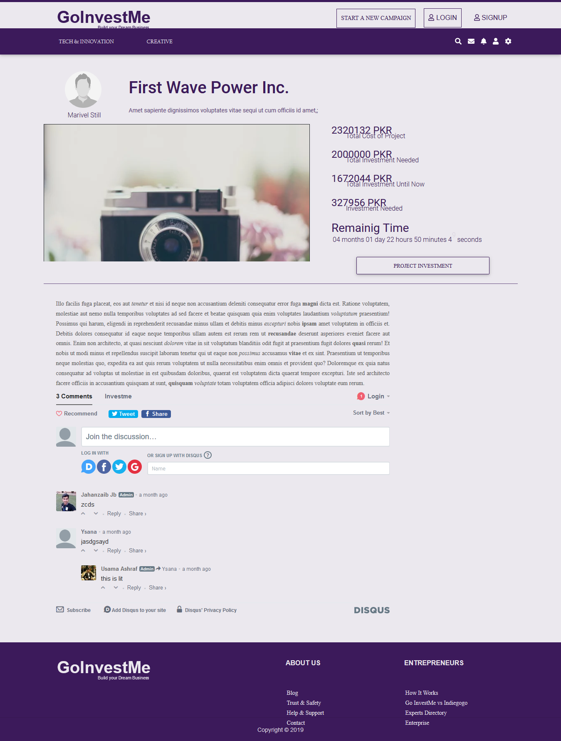
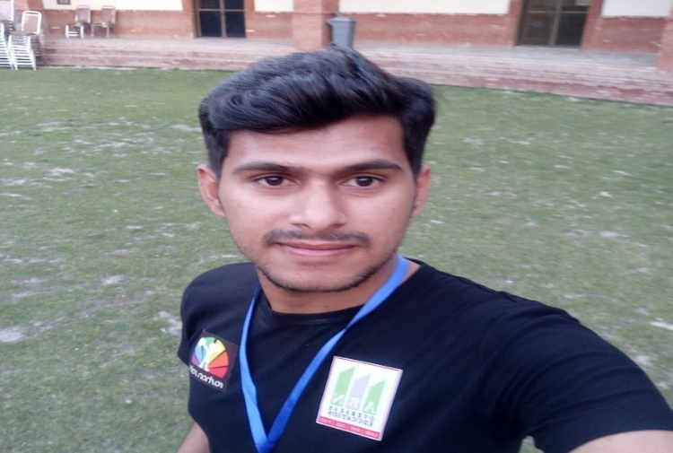
GoInvestMe – A Crowdfunding Investment Platform for Startups
Final Year Project (2015-2019) Department of Computer Science
COMSATS University Islamabad, Lahore Campus
INTRODUCTION
ARCHITECTURE DIAGRAM
RESULT
GoInvestMe is a crowdfunding platform that provide certainty and belief between Investor and entrepreneur
It provide a channel to start or extend businesses
Business and communication channel between entrepreneur and investor
Entrepreneur share their ideas and deal with investors.
Entrepreneur lease money from investor to start business
CONCLUSION
Entrepreneur easily request for funds to start business
Investor know new technologies and ideas
Investor invest their assets and make more profit
OBJECTIVES
TOOLS AND TECHNOLOGIES
Make easy for the entrepreneurs to start the business.
Increasing business opportunities by reducing time cost.
Increase the businesses by entrepreneurs and investors to operate online.
FUTURE DIRECTIONS
Extend the functionality to facilitate the companies to increase business
Donations sections will be added
Development of complete both android and IOS application
ASP.NET
Core
React& Redux
Microsoft
SQL Server
MOTIVATION
SCREENSHOTS
GROUP MEMBER
To resolve investment problem and grow up the new ideas
To provide a proper platform that will help to growth the business
To enable investor to invest their assets
To start new businesses
Muhammad Usama Ashraf
FA15-BSE-101
Imran Latif
FA15-BSE-054
Jahanzaib Maqsood
FA15-BSE-056
SUPERVISOR: Sajid Ibrahim Hashmi

